Slide 1

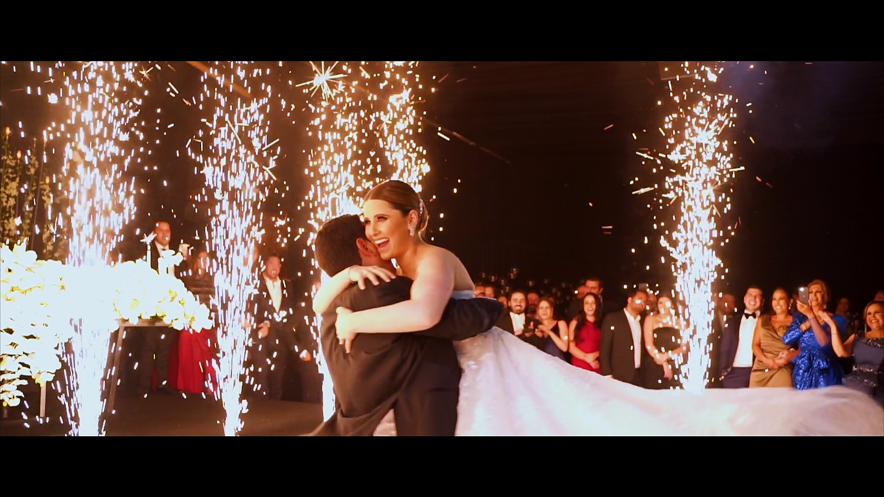
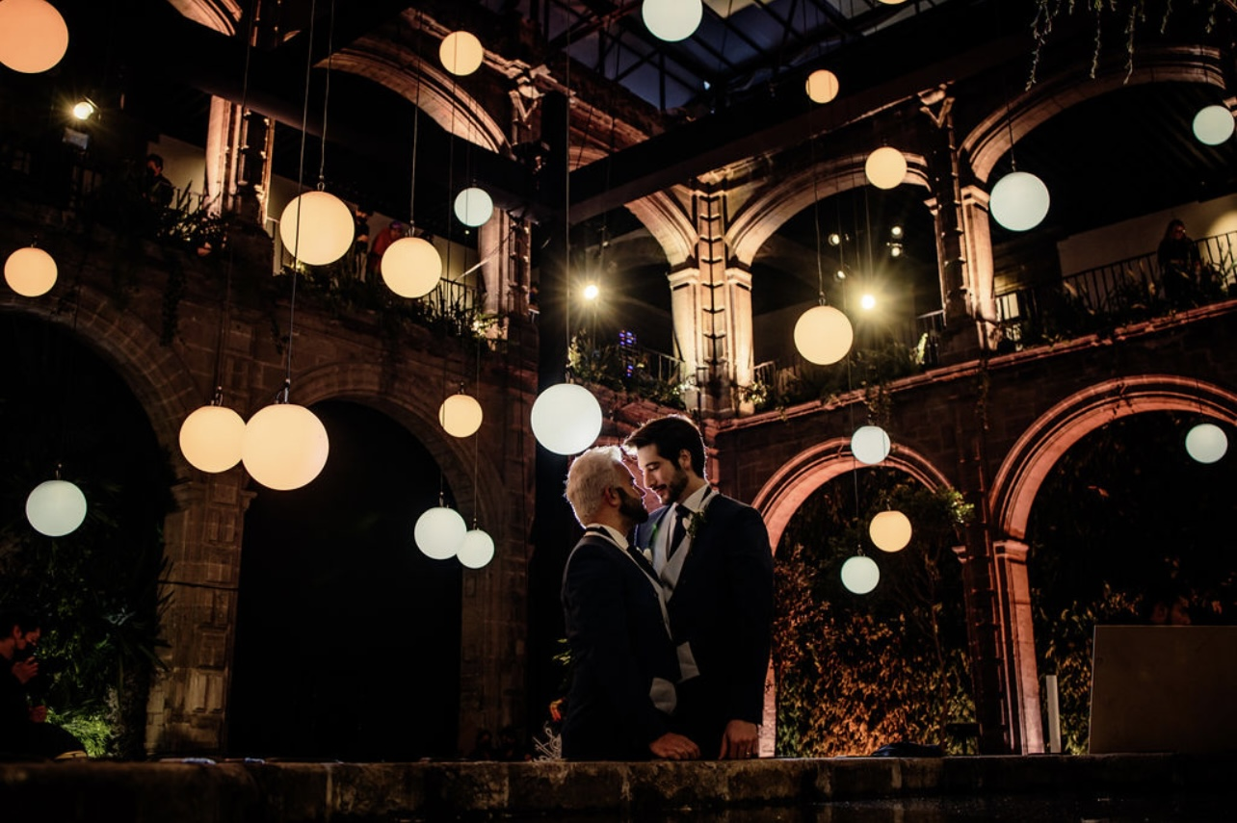
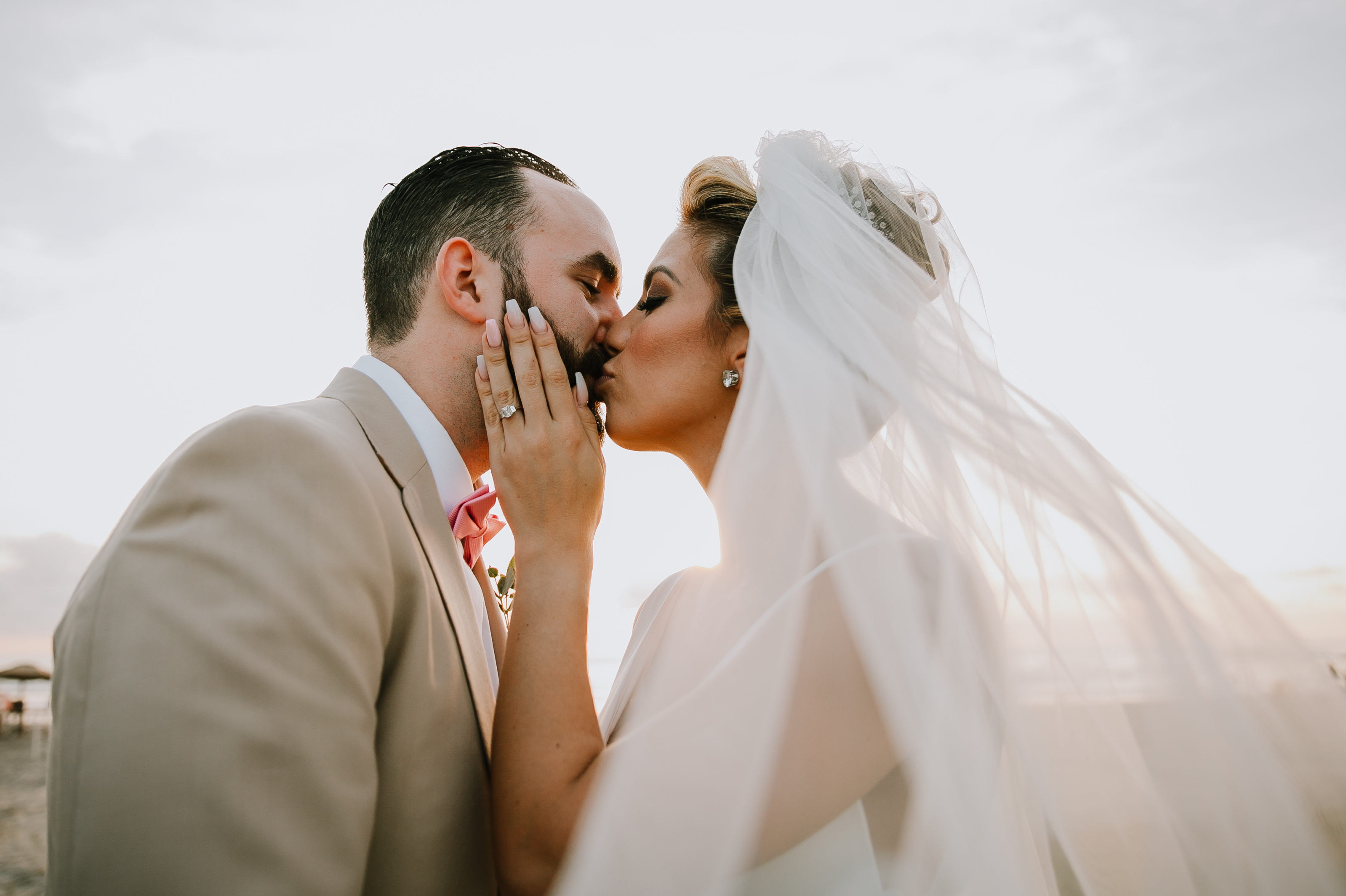
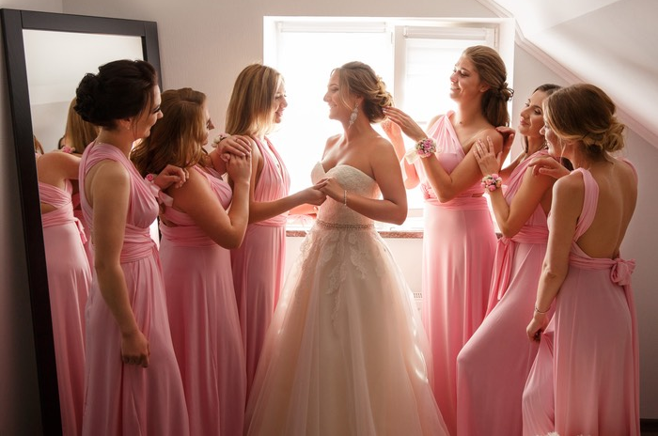
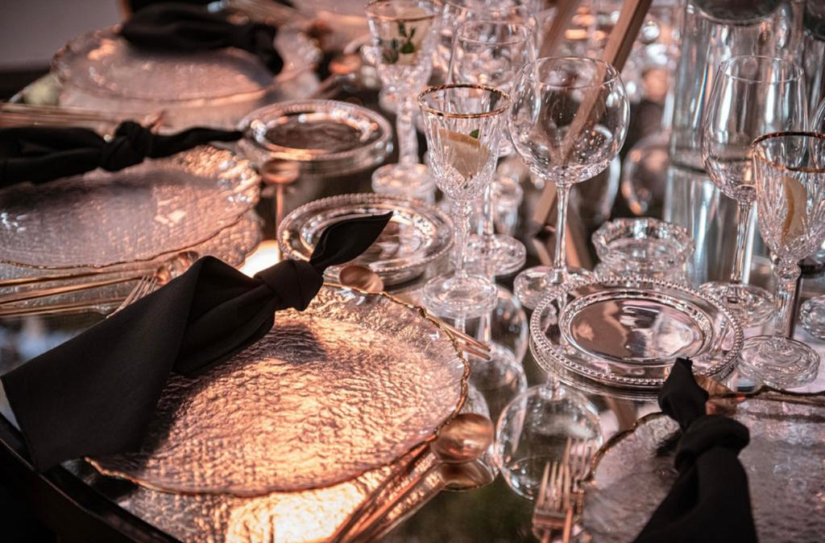

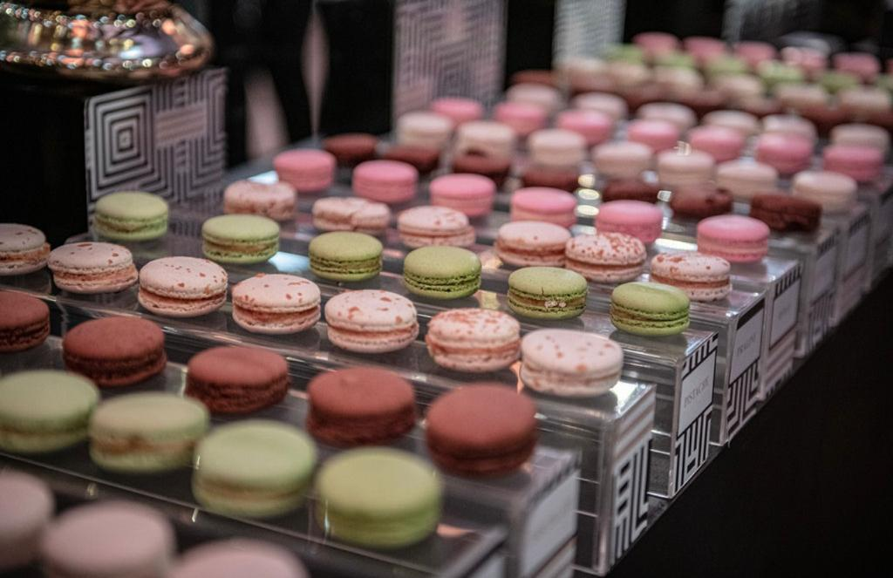
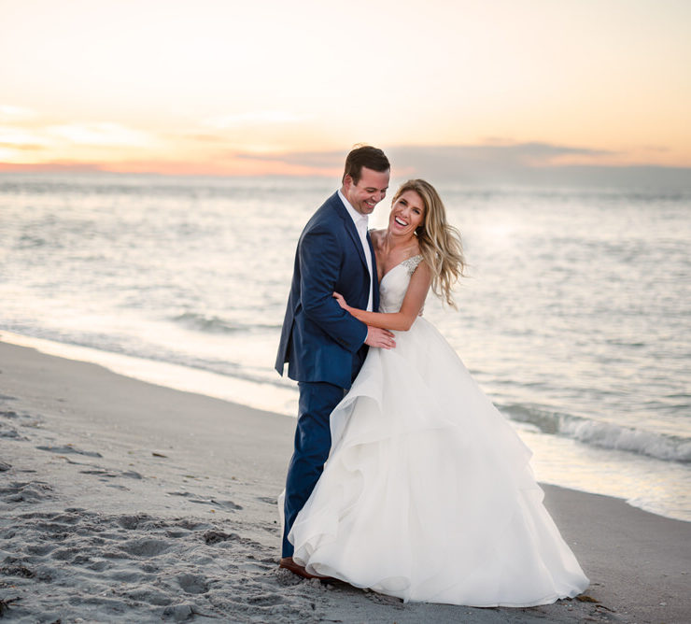
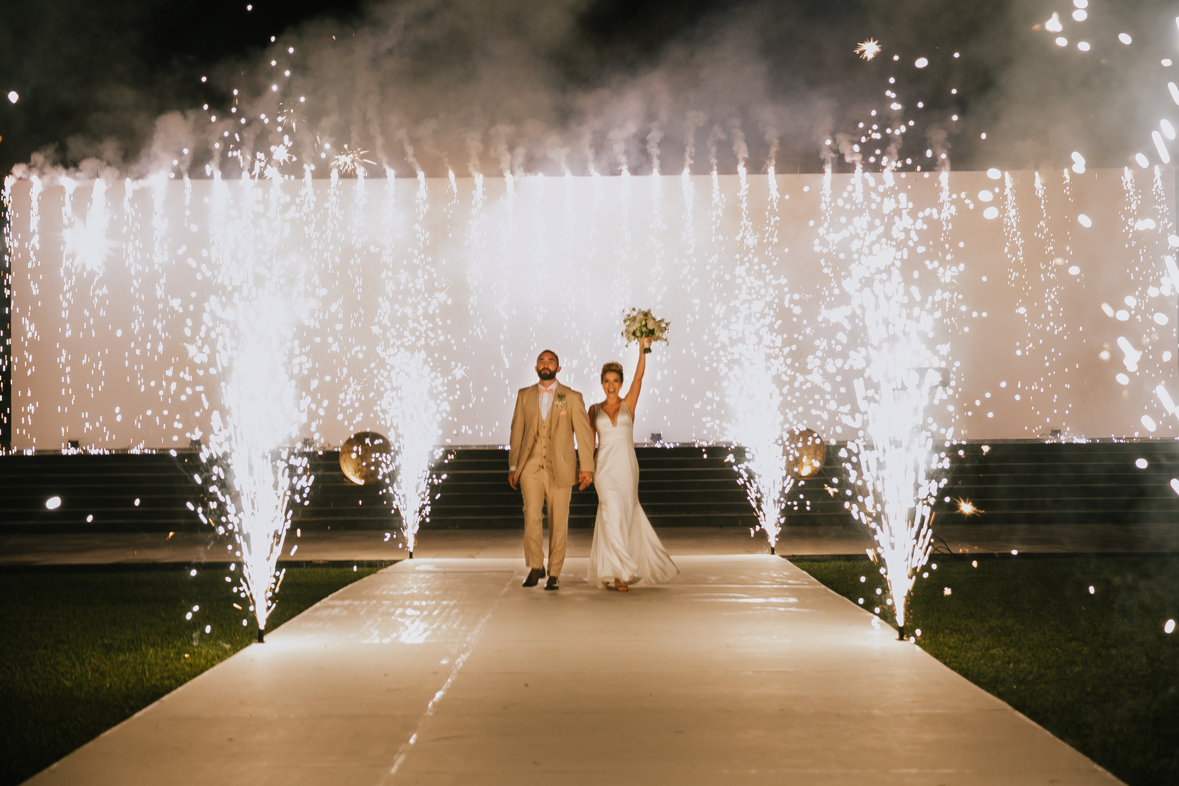
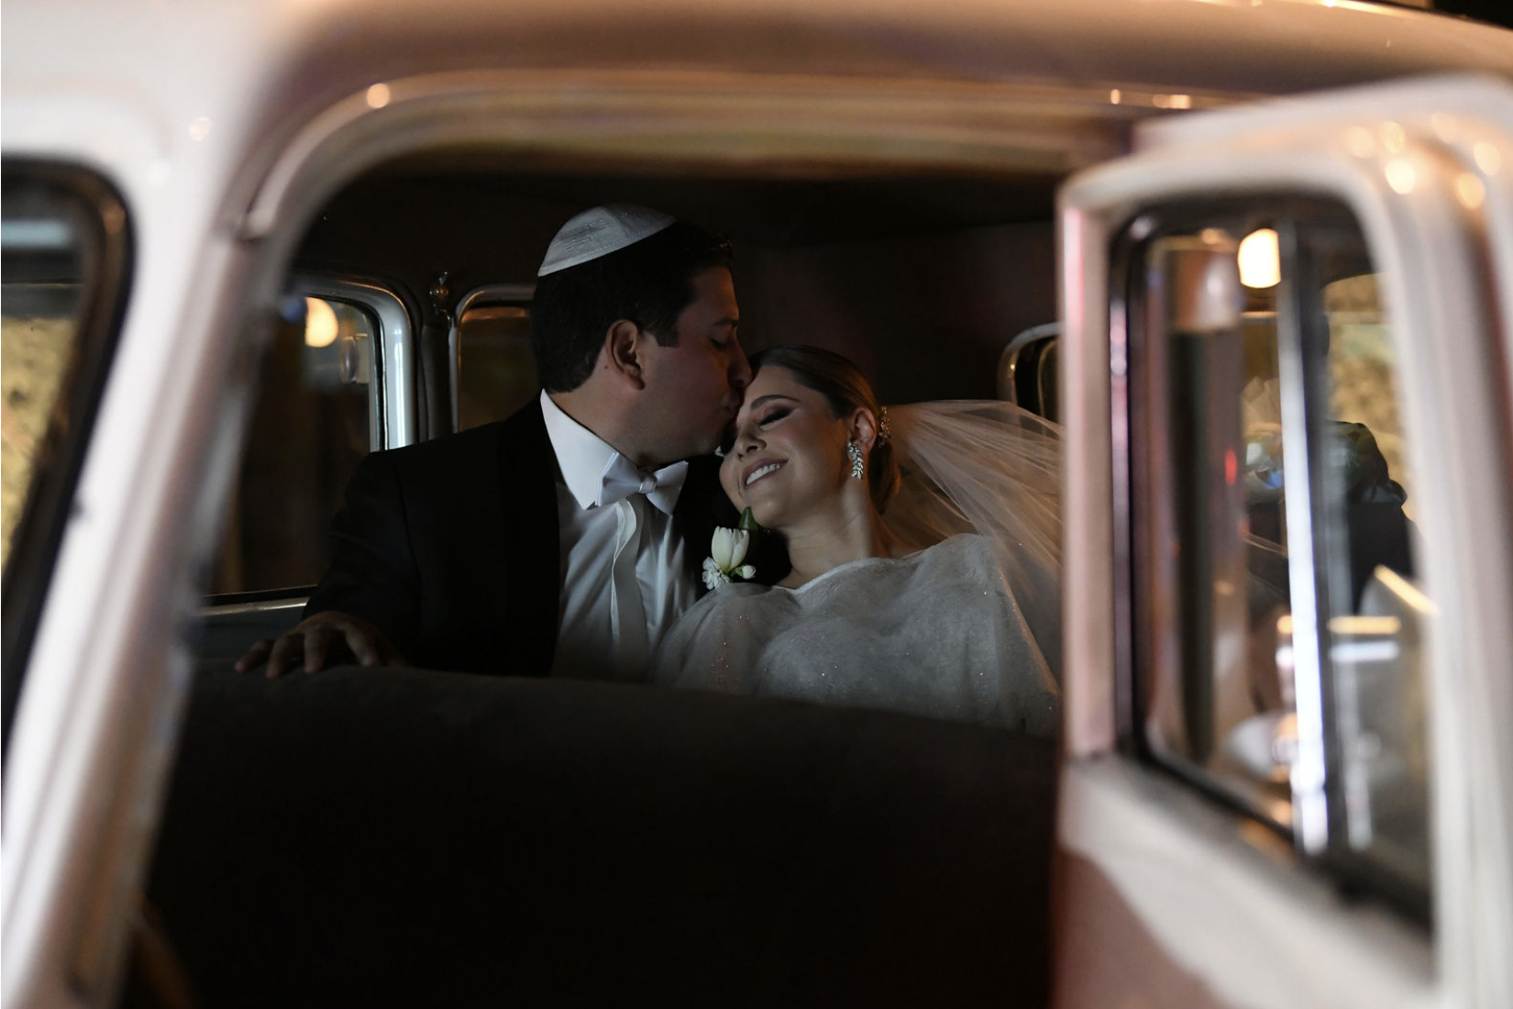

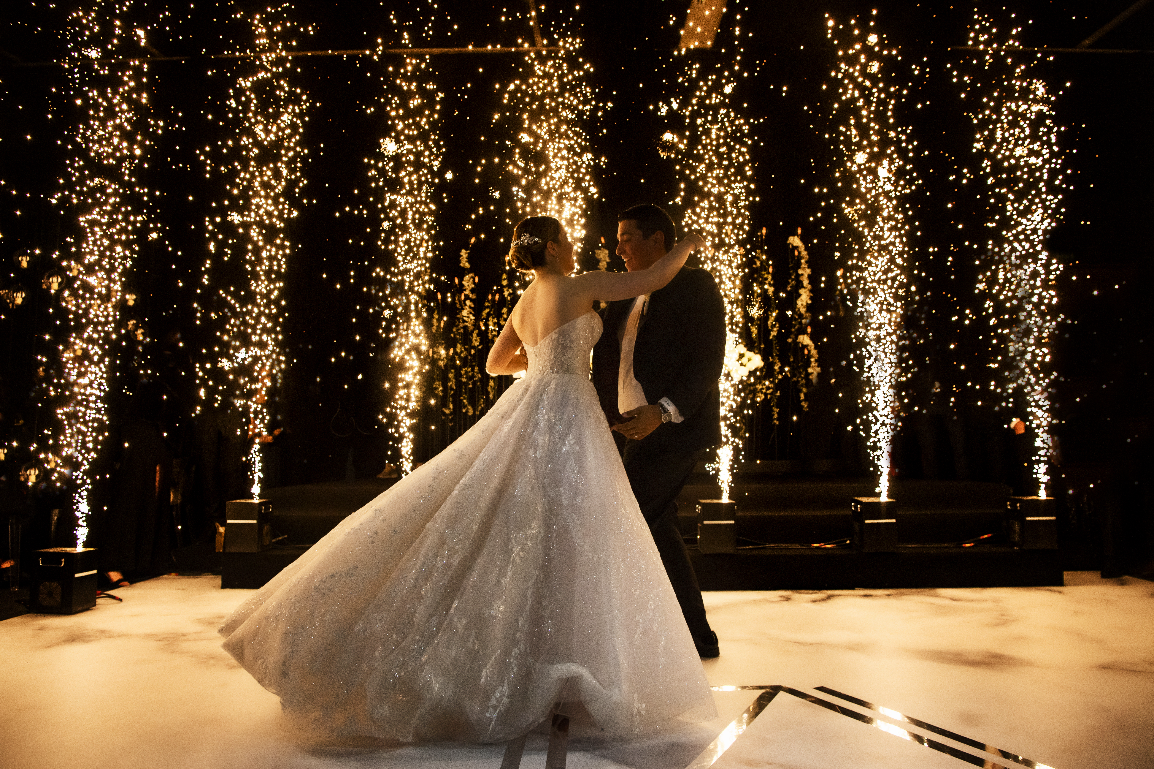
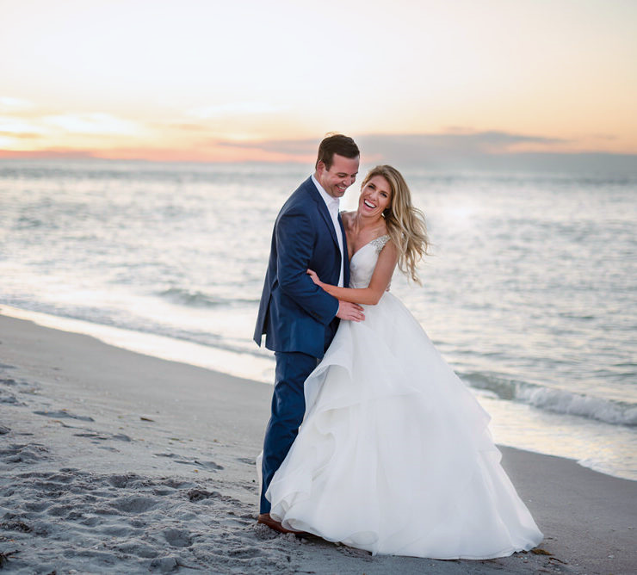
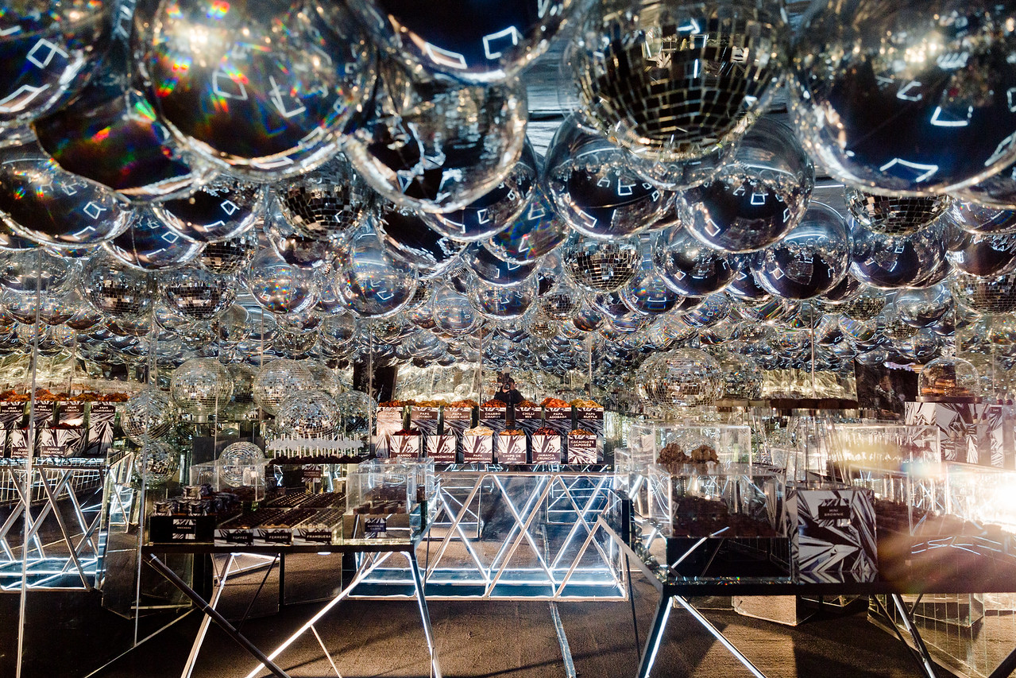













ABOUT US
EVENTS
GALLERY
SERVICES
PRESS
CONTACT
EN
PAUSE | AUDIO
ABOUT US
DG Event Planning purpose as a company is to meet the needs of our clients
by advising them in every step of the event planning process, ensuring
all their expectations are met by carefully taking care of every aspect
and bringing their vision to life. We provide our clients with optimal talent
and consistency, creative and unique ideas; giving beauty and harmony
to every detail, our most important goal is that our clients can enjoy the
process of planning as we help them create the most memorable life experiences.
GALLERY
SERVICES
LIFE IS WORTH
CELEBRATING
PRESS
DG Event Planning 2022©
web design by

Slide 2






ABOUT US
EVENTS
GALLERY
SERVICES
PRESS
CONTACT
EN
PAUSE | AUDIO
ABOUT US
DG Event Planning purpose as a company is to meet the needs of our clients
by advising them in every step of the event planning process, ensuring
all their expectations are met by carefully taking care of every aspect
and bringing their vision to life. We provide our clients with optimal talent
and consistency, creative and unique ideas; giving beauty and harmony
to every detail, our most important goal is that our clients can enjoy the
process of planning as we help them create the most memorable life experiences.
GALLERY
SERVICES
LIFE IS WORTH
CELEBRATING
PRESS
DG Event Planning 2022©
web design by

